Slide 1






Press Conference
9 October 2025
Breaking Visible and Invisible Barriers

Slide 2

Universal Design Award Scheme (UDAS)
The EOC launched the first UDAS last year.
To recognise companies and organisations that excel in implementing universal design principles.
To encourage more organisations to start and continue their efforts in increasing accessibility through sharing of good practices and innovative approaches.
The first UDAS received enthusiastic responses from public and private organisations, with a total of 104 companies and organisations submitting applications for 270 premises.
Building on the enthusiastic support from various sectors for the first UDAS, the EOC is introducing the UDAS 2026/27.

Slide 3

Breaking Barriers:
Insights from the EOC’s Cases
Building a truly accessible society where everyone can participate equally requires the removal of visible barriers existing in the physical environment, as well as the hidden invisible barriers at the operational and attitudinal levels.
By effectively applying the user-centered design principles of universal design, from the design process to the provision of products, environments, services, and solutions, the focus is on the needs of users, aiming to remove both visible and invisible barriers so that everyone can easily enjoy the benefits of the design.

Slide 4
Breaking Barriers:
Insights from the EOC’s Cases
Right to Accessibility:
Article 9 of the United Nations Convention on the Rights of Persons with Disabilities stipulates that Persons with disabilities (“PWDs”) have the rights to live independently and participate fully in all aspects of life in an accessible environment.
In Hong Kong, the Disability Discrimination Ordinance prohibits discrimination and harassment based on disability in access to premises, provision of goods, services and/or facilities; and disposal and/or management of premises.

Slide 5
Breaking Barriers:
Insights from the EOC’s Cases
This is the Equal Opportunities Commission’s first review of complaints related to the Disability Discrimination Ordinance, summarising common operational and attitudinal barriers and compiling them into a guideline.
It provides recommendations to service providers and managers of premises on eliminating these barriers, aiming to prevent PWDs from encountering operational and attitudinal barriers when accessing services or premises.
By examining real cases, we have identified 11 common types of operational and attitudinal barriers and offered suggestions for improvement.

Slide 6






























UDAS 2026/27 Supporting Organisations
(In alphabetical order)

Slide 7
UDAS 2026/27 Application Categories
1. Shopping Malls and Retail Spaces
New Categories
2. Office Buildings and Office Spaces
6. Public and Private Residential Buildings
3. Restaurants
7. Higher Education Institutions
4. Buildings and Sites with Recreational, Sports and Cultural Purposes
5. Revitalised Sites

Slide 8






UDAS 2026/27 Categories of Award
All Applicants
Award-winning Premises of the UDAS 2024/25
Bronze Award
Double Gold Award
Silver Award
Continuous Improvement Award
Gold Award
Special Recognition Award

Slide 9




UDAS 2026/27 Bonus Points
Training
Items on the Self-assessment Checklist that align with the strategic goals of the EOC
Enhancing employee awareness and sensitivity
Harnessing positive momentum
Promoting change in organisational culture

Slide 10






Breaking Barriers:
Insights from the EOC’s Cases

Slide 11


Barriers to Accessibility
Physical barriers: visible obstacles that impede movement or access.
Operational barriers: policies, procedures or practices that do not meet the needs of PWDs and may directly or indirectly restrict or obstruct their use of services and premises.
Attitudinal barriers: behaviours that are consciously or subconsciously caused by prejudice, ignorance, misunderstanding or stereotypes towards PWDs.

Slide 12


Unlawful Acts
Direct Disability Discrimination: may occur when treating a person less favourably on the ground of his/ her disability in similar circumstances.
For example, a restaurant manager refuses to provide service to a wheelchair user because of his/ her disability.
Indirect Disability Discrimination: involves imposing a seemingly neutral condition or requirement on everyone that results in a disproportionate adverse effect on a person with a disability, and it cannot be demonstrated that imposing this condition or requirement is justified.
For example, the lift control buttons in a multi-storey building do not have braille, and that persons with visual impairments are unable to identify the floor numbers on the buttons, it may give rise to indirect discrimination if the building owner does not provide any alternatives and that the arrangement cannot be justified.

Slide 13

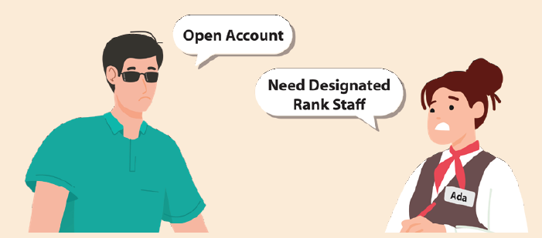
Operational Barriers
A. Discriminatory or Inflexible Policies
Require Designated Staff to Provide Basic Services without Reasonable Justification: A banking service provider established a requirement in its internal guidelines, stating that staff of a designated rank were required to witness a customer with visual impairments when opening a bank account. Due to an insufficient number of staff holding the designated rank at the time, the customer with visual impairments was unable to access the service.
This requirement was found to be more stringent for PWDs than for non-PWDs, as industry practice only stipulates that a staff member act as a witness, without specifying a designated rank.
Notes:
All English wordings ‘case examples’ will be translated to Chinese including the wordings in graphics.

Slide 14

A. Discriminatory or Inflexible Policies
Obtaining Diagnostic Proof Within a Specified Timeframe: A customer with diabetes presented a letter issued by a public hospital certifying his/ her diagnosis and condition, as well as the necessity to carry medical supplies (syringes, needles and insulin) in carry-on baggage when checking in. The airline rejected this, claiming that the customer had to provide a declaration completed by a doctor within ten days before the flight departure date, using a designated form provided by the airline.
However, according to the Airport Authority Hong Kong, diabetic passengers are allowed to carry these medical supplies for in-flight use, subject to the provision of medical evidence only, with no restriction on completing airline-issued form(s) for a diagnosis within a specified timeframe.
Refund Option Not Accessible to All: A customer with a disability purchased a drama ticket online. After the drama was cancelled, the event organiser offered only one refund option, requiring all customers to visit a designated venue in person for a cash refund.
Some customers with certain disabilities who may experience more difficulties should be given more attention in this policy design process, such as providing alternative methods like refunds at different box offices or online.

Slide 15


B. Lack of Guidelines, Policies or Briefings for Serving PWDs
Guidelines and Briefings Unavailable: A restaurant staff member asked a customer in a wheelchair to leave, citing a lack of available seating despite vacant seats being present. It was later found that the restaurant had no guidelines or briefings in place for staff regarding accessibility issues.
Other example: A customer with eczema was denied service by a staff member who misinterpreted a notice for customers seeking further assistance.

Slide 16

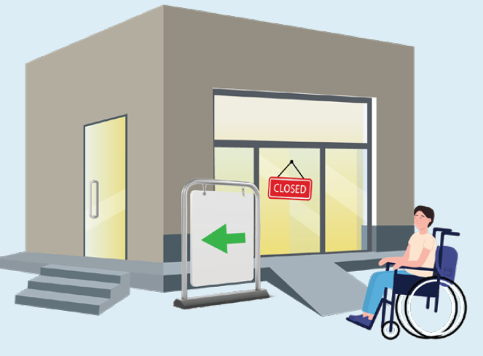
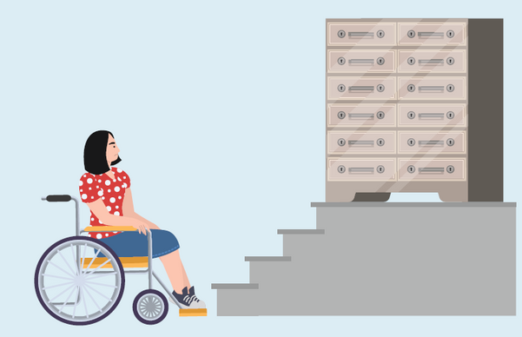
C. Inadequate Initial Planning Considerations for Accessibility
Limited Opening Hours for an Accessible Entrance: A shopping mall closed its most accessible entrance at night, which featured fewer steps and a ramp. This forced PWDs to use the side entrance, which had wider steps and no ramp.
Inaccessible Service Locations: A wheelchair user was unable to access the safe deposit box located on an upper floor, which was only accessible by stairs, depriving them of physical access to the service.
Other examples: longer route to accessible entrance, feasible ramp access not planned, heavy doors along the route inside a shopping mall, restricted access to elevators, obstructed views at events, insufficient space of accessible toilets and inadequate size of accessible parking spaces.

Slide 17



D. Management and Maintenance Issues
Restricted Access: A wheelchair user found that the door of an accessible toilet in a hospital was marked with a sign stating “Staff only.” However, this accessible toilet was originally intended to be open to both the public and hospital staff. This practice prevented him/ her from using the facility.
Blocked Ramps: Some shop operators on the ground floor of a shopping mall blocked ramps with boxes, obstructing access for wheelchair users.
Delayed Action: An elderly adult who has become a wheelchair user has since been unable to enter or exit his/ her residence freely due to a step between the residence lobby and the lifts. The Owners’ Corporation approved a motion to install a ramp in the lobby, but the work has been delayed because it was considered a lower priority than other projects.
Other examples: broken locks of accessible toilets, obstruction to barrier-free shower compartment entrance.

Slide 18

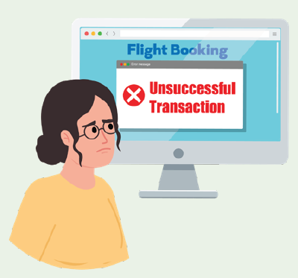
E. Online Service Barriers
Inaccessible Website: A person with a visual impairment encountered difficulties when purchasing flight tickets online from an airline’s website. The person’s screen reader was unable to interpret the date selection function due to design issues, and the CAPTCHA requirement did not provide alternative text at the payment stage, resulting in an unsuccessful transaction.
Other example: Tickets for the museum can only be purchased online.

Slide 19

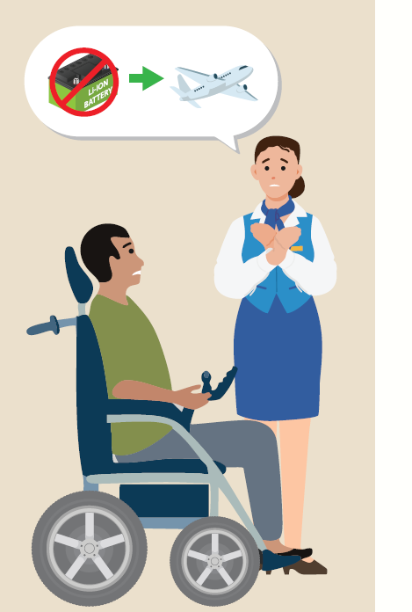
F. Poor Staff Training and Awareness
Misconceptions about Guidelines: A staff member rejected an electric wheelchair user from bringing lithium-ion battery on board a flight, even though other staff members and industry regulations had confirmed that the request was permissible. The user had to negotiate with several staff members and was given different replies, which was unnecessary as the user was ultimately allowed to bring the battery.
Lack of Knowledge about Tactile Guide Paths: A manager misplaced positional tiles instead of hazard warning tiles in specific locations due to insufficient understanding of the different types of tactile paving. Also, areas that were seldom used lacked tactile guide paths, which adversely affected wayfinding for persons with visual impairments.
Other examples: denial of providing a ramp, elevator locked by staff and staff making fun of a client’s disability.

Slide 20

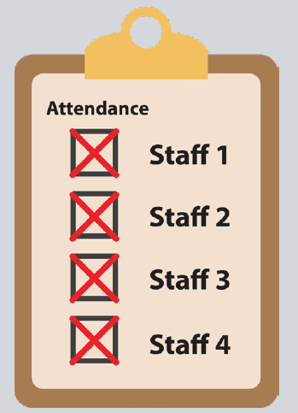
G. Poor Awareness of Vicarious Liability
A service provider claimed to have taken steps to prevent discrimination by its staff through the circulation of equal opportunities policies and the provision of anti-discrimination training. However, it was later revealed that the provider had failed to deliver adequate and comprehensive equal opportunities policies to all staff, and had no system in place to ensure that staff acknowledged their understanding of the policy or attended the training.

Slide 21

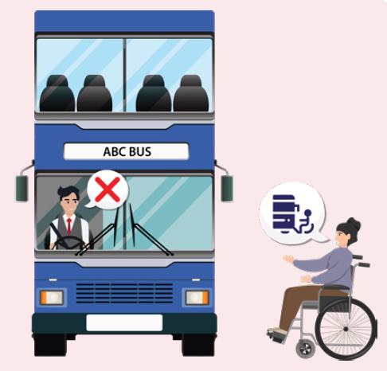
Attitudinal Barriers
Refusal to Provide Services or Assistance
Ignored Request for Access: A bus driver ignored a request from a wheelchair user to lower the bus and deploy the ramp for wheelchair access, then drove away without allowing the passenger to board.
Other examples: Restaurant staff refusing to serve or assist diners who use wheelchairs.

Slide 22

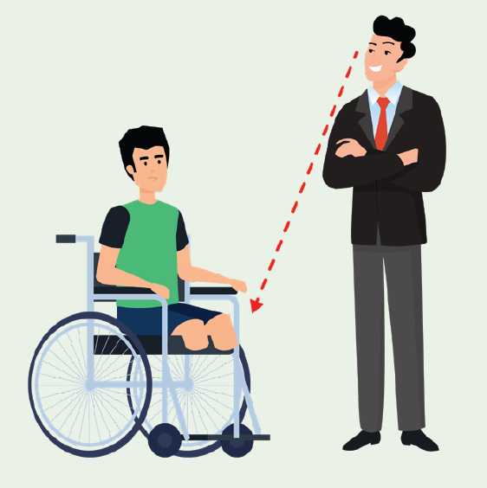
B. Unfriendly Treatment
Harassing Remarks: A professional used an arrogant tone and made harassing remarks on account of a young client’s disability during a consultation session, frightening the client and causing distress.
Other examples: Frontline staff hold a hostile attitude towards a person with mental health condition, and angrily refused the requests of wheelchair users.

Slide 23


C. Poor Communication
A massage shop’s frontline worker refused to provide a massage service to a client with eczema solely based on his/ her condition. The staff member did not explain that providing the service might exacerbate the client’s condition.
A staff member at a beauty salon refused to provide a facial treatment to a client with asthma, repeatedly stating that it was company policy not to serve individuals with asthma. The staff member did not explain that further medical advice could be sought if necessary.

Slide 24

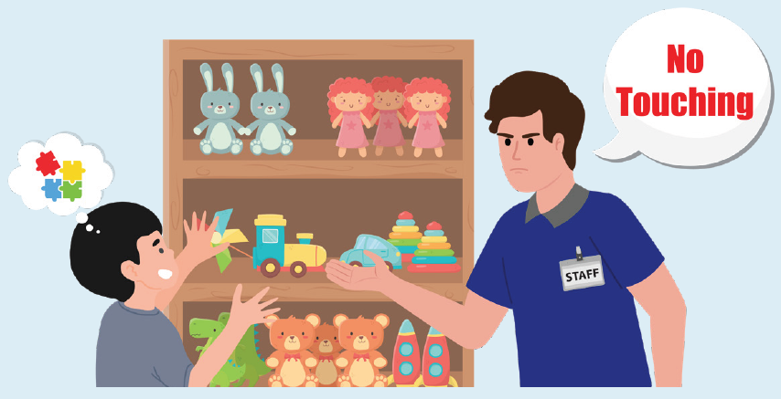
D. Lack of Response to Complaints
A person with multiple disabilities, including intellectual disabilities and autism, was warned not to touch anything in a retail store. After the person was scolded for lightly checking a product in a separate incident, their representative submitted two complaints directly to the retail chain but received no response.

Slide 25


Breaking Barriers
Policy Review
Conduct A Policy Review: Identify and remove discriminatory practices, and amend inflexible internal policies and guidelines to allow for flexibility and discretion.
Ensure Adherence to Local Statutory Codes and Industry Guidelines: Verify that internal policies comply with local statutory codes and industry guidelines, ensuring correct interpretation. E.g., the “Guidance for Airline Operators in Hong Kong: Facilitation of Persons with Reduced Mobility in Air Travel” (issued by the Civil Aviation Department)
Offer Reasonable Accommodation or Alternatives: Recognise that PWDs may find it challenging to meet the same requirements as others. Reasonable accommodation (“RA”) or alternatives should be provided to support PWDs. RA refers to any modifications or adjustments made to the provision of GSF or access to premises to ensure that PWDs have equal opportunities to access the service or premises. RA may include modifications made to the physical environment, policies, procedures or practices.
Establish Customer Service Protocols: Develop clear guidelines and conduct regular briefings for staff on serving people with diverse needs, including the necessary skills and attitudes.

Slide 26
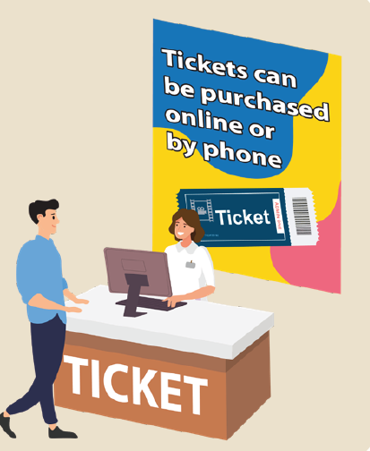

Develop Flexible Policies: Provide multiple options for accessing services, including online, telephone and email support, as well as in-person assistance
Implement Policies Effectively: Ensure that all staff have a thorough understanding of internal policies and protocols and implement them effectively.
Enable Diverse Service Options: Ensure access to service options for customers with diverse needs, such as providing more wheelchair seating choices in stadiums.
Make Accessibility Information Available Online: Provide information about accessible facilities and services on websites and mobile app platforms, , allowing customers to plan their visits in advance.
Offer more ticket purchase and refund options, including both online services and offline options at various box offices.
Set aside an annual itemised budget for accessibility improvement works.

Slide 27
2. Accessibility Planning
Accessible Environment: Provide an accessible environment unless doing so would cause unjustifiable hardship.
Universal Design (“UD”) Principles: Integrate UD from the beginning of any project rather than as an afterthought. The key is to put yourself in the shoes of those in need, creating products, services and environments that everyone can access and use.
Endeavour to Meet the Design Manual: Barrier Free Access (DMBFA) 2008 or the latest available version, including its mandatory and recommended requirements, as well as other best practices or guidelines. E.g. ensure provisions for ramps and minimum door widths are met.
Accessibility Improvement Works: Include accessibility upgrades in the building’s maintenance programme and implement the approved improvements within a clear timeframe.

Slide 28

Prioritise High-Traffic Retrofits: Focus on retrofitting inaccessible entrances, adding braille and tactile floor plans, and ensuring toilets are accessible, manoeuvrable and unobstructed.
Consultation with PWDs: Involve PWDs in the initial planning and design phases to gain a better understanding of user perspectives.
Wheelchair spaces are interspersed among regular seats in stadiums, performing arts venues or cinemas to provide more choices for PWDs and to prevent segregation, with companion seats located adjacent to these spaces.
Parking spaces are designated to allow drivers with disabilities to fully open their car doors and place their wheelchairs.

Slide 29
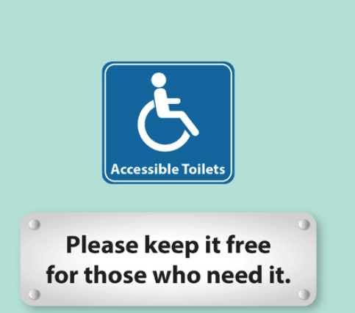
3. Operational Maintenance
Accessibility Maintenance: Establish an accessibility maintenance log and conduct regular inspections, including checks on elevator functionality, misuse of accessible toilets, etc.
Assign an “Access Officer”: Oversee compliance with accessibility standards, and conduct regular assessments to identify and address accessibility issues, including institutional, operational and attitudinal barriers.
Keep the accessible toilets doors open and provide information on how to obtain assistance if the door is locked for any reason.
Display reminders for the public to refrain from misusing the accessible toilet, such as: “Please keep it free for those who need it.”
Ensure that the route to the lifts remains unobstructed for easy access.

Slide 30
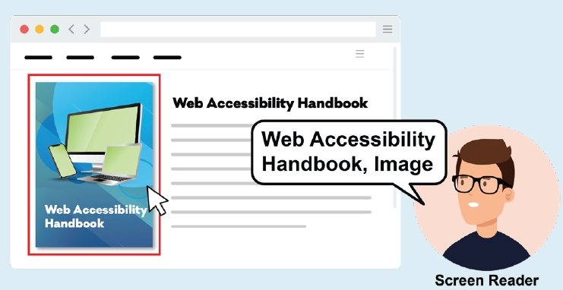
4. Digital Accessibility
Adopt Accessible Website and Mobile Design by referring to the Web Content Accessibility Guidelines.
Conduct Regular Accessibility Audits: Engage PWDs in user testing to identify barriers wherever possible.
Provide text alternatives (“Alt text”) for images, videos, and other non-text content.
Provide alternative forms of CAPTCHA to accommodate different types of sensory perception, such as audio CAPTCHA.
Use high-contrast colour schemes and resizable fonts.

Slide 31
5. Staff Training and Accountability
Comprehensive Training for Frontline Staff: Offer training on equal opportunities and anti-discrimination, such as disability etiquette and tips on handling service animals.
Equal Opportunities Training for Management: Ensure that corporate policy planning is non-discriminatory and promotes inclusivity. E.g., workshops on understanding the special needs of people with various disabilities in their journey to accessing services and premises.
Compliance Awareness Training: Raise awareness of legal obligations under anti-discrimination laws to eliminate discrimination and harassment, including the rights and responsibilities of both employees and employers, especially employer’s vicarious liability for unlawful acts.
Sensitivity Training: Enhance staff’s understanding of the diversity of disabilities and to reduce stereotypes about customers with varying needs, such as simulation workshops.

Slide 32
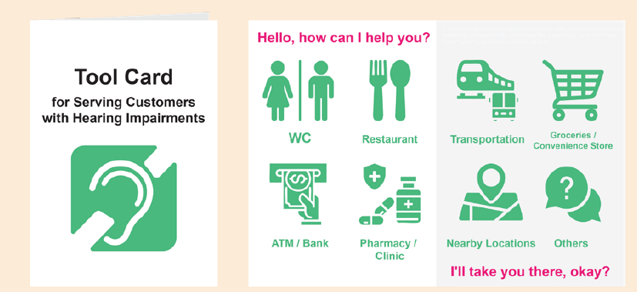
Ensure Attendance: Make sure that all staff have attended anti-discrimination training and maintain records to ensure accountability.
Knowledge of Accessible Facilities and Services: Ensure that all staff have a thorough understanding of the available accessible facilities and services so they can provide the necessary assistance. E.g., they should know how to place a portable ramp
A tool card designed to assist customers with hearing impairments.

Slide 33

6. Communication Improvements for Frontline Staff
Introduce Yourself and let customers know that you are available to assist them.
Refrain from making assumptions about people’s abilities and needs. Provide choices and respect their dignity, just as you would for anyone else.
Always speak or communicate directly and face-to-face with customers who have needs.
Offer assistance when appropriate. E.G., “Would you like any assistance?”
Be Patient and be prepared to clarify or repeat information as needed.
Provide written or visual information to assist customers when necessary.
When persons with visual impairment(s) accept assistance with guidance, offer your elbow for them to hold. Walk at a normal pace.
Describe any obstacles ahead (e.g., “We’re approaching a step down”).
Indicate direction using “clock-face” spatial language (e.g., “Turn to the 2 o’clock position” is preferable to “A little to the right”).

Slide 34
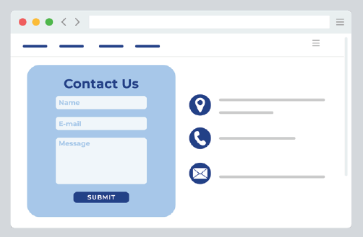
7. Appropriate Attendance to Feedback and Complaints
Provide multiple options for submitting feedback or lodging complaints. E.g., online forms, live chat, or in-person visits.
Ensure that large-print and easy-to-read versions of feedback forms are readily available.
Designate a staff member to manage complaints and ensure compliance with procedures.
Establish clear handling procedures and ensure that all relevant parties are informed of them.
Designate a single contact person to handle each complaint, as it can be frustrating for complainants to deal with multiple contacts.
Keep complainants and respondents informed.
Maintain detailed records of every complaint received, updating them as actions are taken and including the overall outcome. Ensure these records are monitored for recurring issues.
Ensure that the handling process and outcomes are fair. Summarise the pain points of complaints and use them to enhance staff training and improve service quality.

Slide 35
8. Make Use of Assistive Technology
Service providers and managers of premises should utilise these tools to improve accessibility and broaden their customer base.
Key Innovations and Applications:
Communication: Screen readers vocalise digital information for persons with visual impairments, facilitating their access to information.
Media and Entertainment: Closed captions, subtitles, and audio descriptions make television programmes and films accessible to audiences with hearing or visual impairments.
Arts and Culture: Virtual reality can create immersive experiences that enable wheelchair users to explore environments that may not be physically accessible to them.
Sports Inclusion: Technologies such as vision pads enhance the experience for persons with visual impairments by providing real-time updates during sporting events or activities.

Slide 36

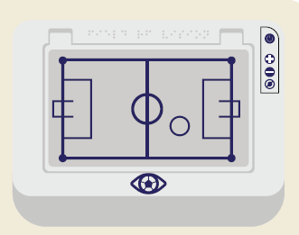
A handheld device with haptic feedback that enables PVIs to “feel” football games. It uses a small magnetic ring to guide the user’s finger around the tablet.
A concert provided vibration vests for audience members with hearing impairments, allowing them to feel the music’s vibrations. It also offered theatrical interpretation that conveyed the content of the songs, the mood of the lyrics, and even the rhythm and emotion of the music.

Slide 37
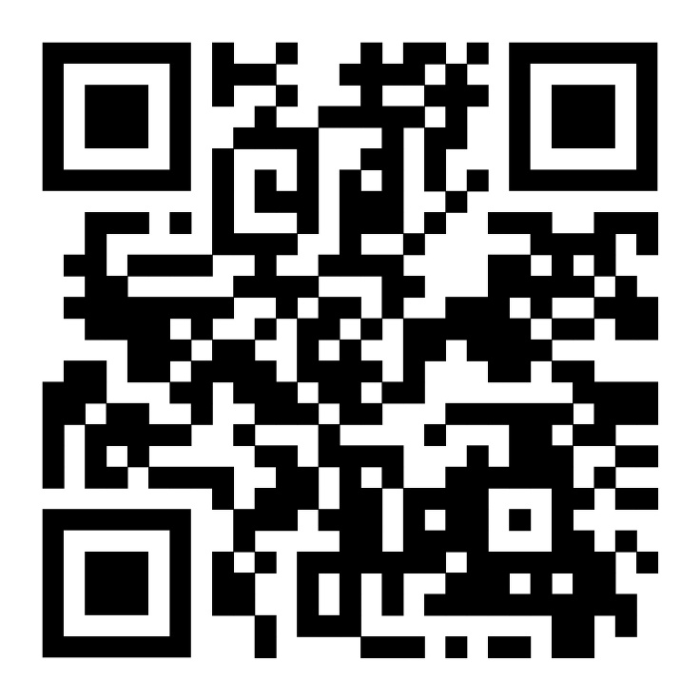

Full Guide
Self-Assessment Checklist

Slide 38


UDAS 2026/27 Tips
Self-assessment Oct 2025 – Mar 2026
Random Site Audits Oct 2025 – May 2026
Selection by Judging Panel Jul 2026
Award Ceremony Oct or Nov 2026

Slide 39
UDAS 2026/27 Tips
2024/25
Self-assessment (122 items)
Covers 10 sections
2026/27
Self-assessment (158 items)
Examples of new items:
Accessible changing room for wheelchair users or individuals with mobility challenges (equipped with features e.g., grab rail, seating, and sliding door)
Install grooves along the edge of service counters, or adopt other effective designs to secure walking sticks or canes
Provide tactile versions of exhibits to enable persons with visual impairment to experience the content through sense of touch
Provide soft meal for people with different degrees of swallowing and chewing difficulties
Access
Door
Services
Furniture and fixtures
Business-specific components
Signage and wayfinding
Toilet
Lift
Ambience
Parking

Slide 40
UDAS 2026/27 Bonus Points
Training
Items on the Self-assessment Checklist that align with the strategic goals of the EOC
Enhancing employee awareness and sensitivity
Participation in the training courses organised by the EOC
Promoting change in organisational culture
Awardees of the Caring Employer Medal 2025 jointly organised by Diverse Abilities · Inclusive Workplace Recognition Scheme of the Labour and Welfare Bureau and Jockey Club Collaborative Project for Inclusive Employment
Harnessing positive momentum
Successful referral of other premises

Slide 41
UDAS 2026/27 Bonus Points
Items on the Self-assessment Checklist that align with the strategic goals of the EOC
Additional handrail for people with different height (e.g., children, elderly), with a lower handrail at a height of no more than 800 mm
Provide Quiet Room or Quiet Hours for those in need of a calm environment
Designated socket with relevant signage for charging electric wheelchair
Audio description tour services or audio description for exhibitions, performances, videos, or sports events
Adult diaper changing facility/foldable nursing bed
Family-friendly / carer-friendly parking space with relevant signage

Slide 42
UDAS 2026/27 New categories of award
Award-winning Premises of the UDAS 2024/25
Double Gold Award
Continuous Improvement Award
Examples of improvement on accessibility
Installation of automatic door(s) at other entrance(s) in addition to the main entrance.
Provision of live captioning through artificial intelligence technology, enabling persons with hearing impairment participate in activities.
Installation of automatic fall detection alarm systems in toilets, using innovative technology to enhance the safety of users.

Slide 43
UDAS 2026/27 Judging Criteria
Award | Points (A+B+C+D+E) |  | Judging Criteria
 | Larger Premises | Smaller Premises
Bronze | 30-49 points | 20-29 points | /
Silver | 50-69 points | 30-44 points | /
Gold | 70 points or above | 45 points or above | Obtaining 60 marks or above in the below Marking Scheme. Scoring will be conducted by the Judging Panel
Special Recognition | Meeting the criteria for Silver or Gold Award |  | With excellent UD provisions and fulfilling the below marking scheme, as deemed by the Judging Panel

Slide 44
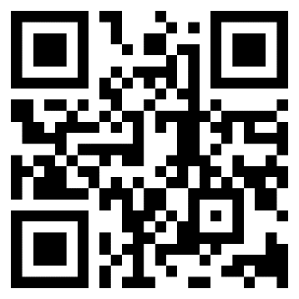
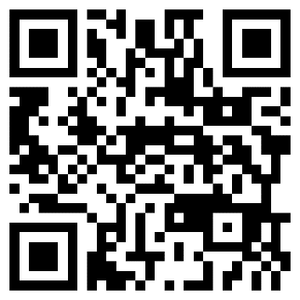
UDAS 2026/27
Applications are accepted starting from today
For enquiries, please contact the EOC
Website： https://www.eoc.org.hk/en/udas
Email： UDAS@eoc.org.hk
Phone：(852) 2511 8211
Website
Brochure

